Slide 1





MAJOR PROJECT
ON
Academic Audit Module
(MCA – IV SEMESTER; BATCH 2024-26)
Presentation by
Kishor Bharti(09411604424)
Soumya Chouhan(01711604424)
Rishabh Baranwal (00711604424)
Project Mentor
MS. Ambooj Yadav
Dr. Sunil Prataap Singh
13-02-2026
‹#›
Bharati Vidyapeeth’s Institute of Computer Applications and Management (GGS IP University) New Delhi, India
© Bharati Vidyapeeth’s Institute of Computer Applications and Management, New Delhi-63
Notes:
1
© Bharati Vidyapeeth’s Institute of Computer Applications and Management, New Delhi-63, by Dr. Sunil Pratap Singh
Enterprise Computing with Java (MCA-305)
1

Slide 2
Contents
Problem Description
Aim and Objectives
Methodology and Technology Used for Project Development
Design Documents (Use Case, Data Flow Diagram, Entity-Relation Diagram)
Screenshots
Testing of Project
Conclusion
Future Scope
‹#›
© Bharati Vidyapeeth’s Institute of Computer Applications and Management, New Delhi-63
‹#›
© Bharati Vidyapeeth’s Institute of Computer Applications and Management, New Delhi-63

Slide 3
Problem Description
Manual academic record management causes inefficiency and errors.
There is no centralized system for managing students, faculty, courses, and marks.
Generating audit reports is complex and time-consuming.
Role-based access and data security are limited.
A secure and scalable digital solution is required.
‹#›
© Bharati Vidyapeeth’s Institute of Computer Applications and Management, New Delhi-63
‹#›
© Bharati Vidyapeeth’s Institute of Computer Applications and Management, New Delhi-63

Slide 4
Aim and Objectives
Aim: To develop a centralized Academic Audit Management System that securely manages students, faculty, courses, marks, and audit reports in an efficient and scalable manner.
Objective:
To implement role-based authentication (Admin, Faculty, Student).
To manage student, faculty, and course records digitally.
To enable marks entry and performance tracking.
To generate structured academic audit reports.
To ensure data security and integrity using modern technologies.
‹#›
© Bharati Vidyapeeth’s Institute of Computer Applications and Management, New Delhi-63
‹#›
© Bharati Vidyapeeth’s Institute of Computer Applications and Management, New Delhi-63

Slide 5
Methodology and Technology Used
Technology used for Project Development:
Front-End: React (Vite), Axios, React Router v6, CSS, JS
Back-End: ASP.NET, Entity Framework Core 10, JWT Authentication
Database: PostgreSQL
‹#›
© Bharati Vidyapeeth’s Institute of Computer Applications and Management, New Delhi-63
‹#›
© Bharati Vidyapeeth’s Institute of Computer Applications and Management, New Delhi-63
Notes:
Enterprise Computing with Java (MCA-305)
© Bharati Vidyapeeth’s Institute of Computer Applications and Management, New Delhi-63, by Dr. Sunil Pratap Singh
5

Slide 6
System Design
‹#›
© Bharati Vidyapeeth’s Institute of Computer Applications and Management, New Delhi-63
‹#›
© Bharati Vidyapeeth’s Institute of Computer Applications and Management, New Delhi-63

Slide 7
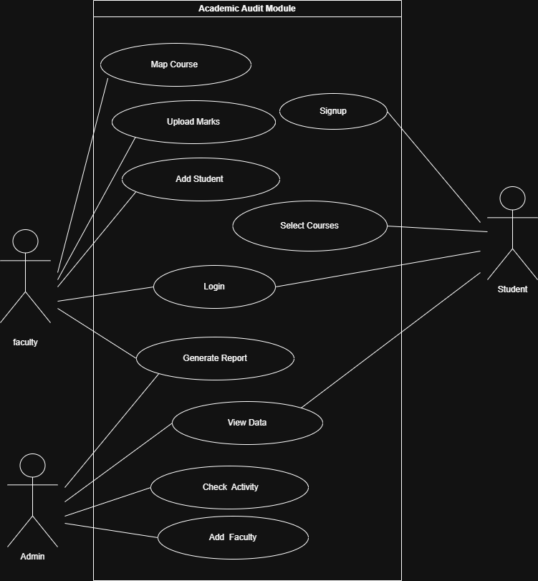
Use Case Diagram
‹#›
© Bharati Vidyapeeth’s Institute of Computer Applications and Management, New Delhi-63
‹#›
© Bharati Vidyapeeth’s Institute of Computer Applications and Management, New Delhi-63

Slide 8
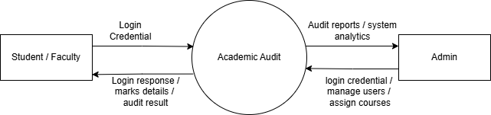
Data Flow Diagram Level 0
‹#›
© Bharati Vidyapeeth’s Institute of Computer Applications and Management, New Delhi-63
‹#›
© Bharati Vidyapeeth’s Institute of Computer Applications and Management, New Delhi-63

Slide 9
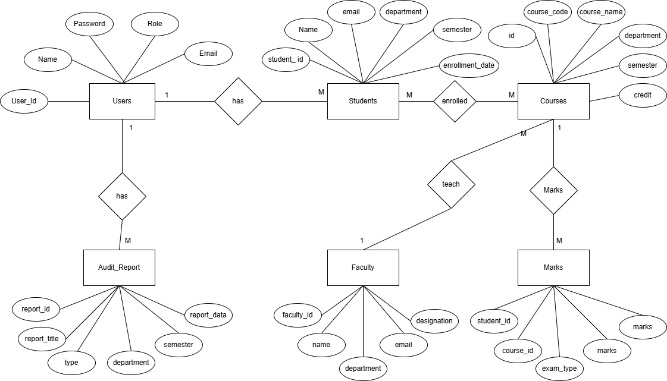
Entity-Relationship (E-R) Diagram
‹#›
© Bharati Vidyapeeth’s Institute of Computer Applications and Management, New Delhi-63
‹#›
© Bharati Vidyapeeth’s Institute of Computer Applications and Management, New Delhi-63

Slide 10
Screenshots
‹#›
© Bharati Vidyapeeth’s Institute of Computer Applications and Management, New Delhi-63
‹#›
© Bharati Vidyapeeth’s Institute of Computer Applications and Management, New Delhi-63

Slide 11
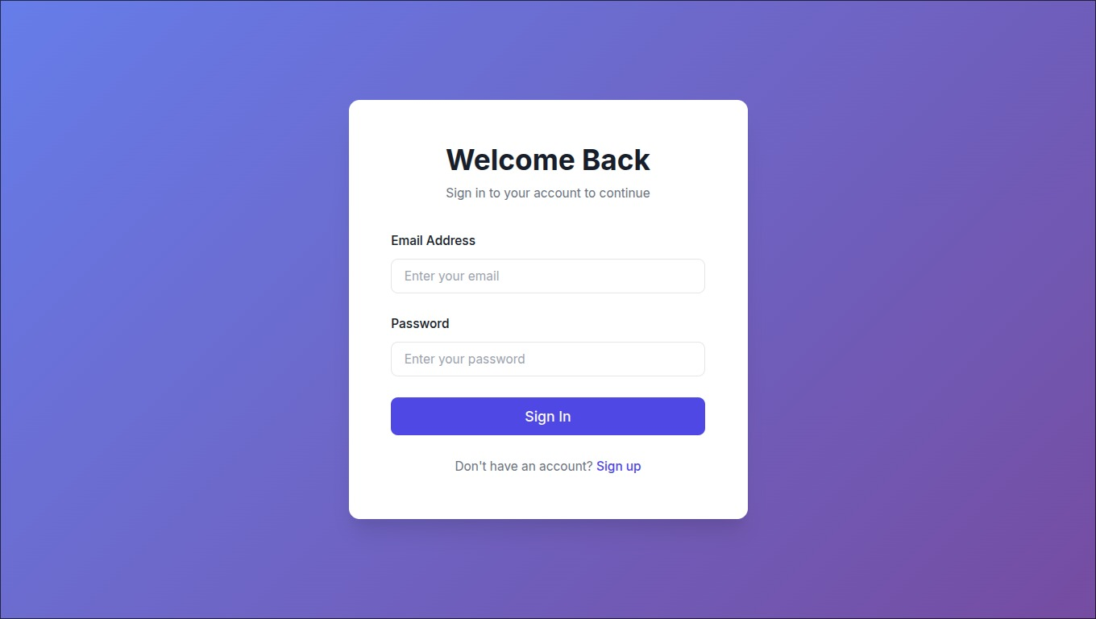
Screenshot – 1 : Login
‹#›
© Bharati Vidyapeeth’s Institute of Computer Applications and Management, New Delhi-63
‹#›
© Bharati Vidyapeeth’s Institute of Computer Applications and Management, New Delhi-63

Slide 12
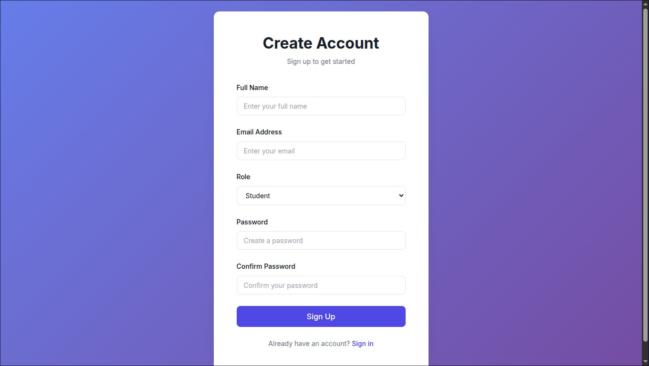
Screenshot – 2 : Signup
‹#›
© Bharati Vidyapeeth’s Institute of Computer Applications and Management, New Delhi-63
‹#›
© Bharati Vidyapeeth’s Institute of Computer Applications and Management, New Delhi-63

Slide 13
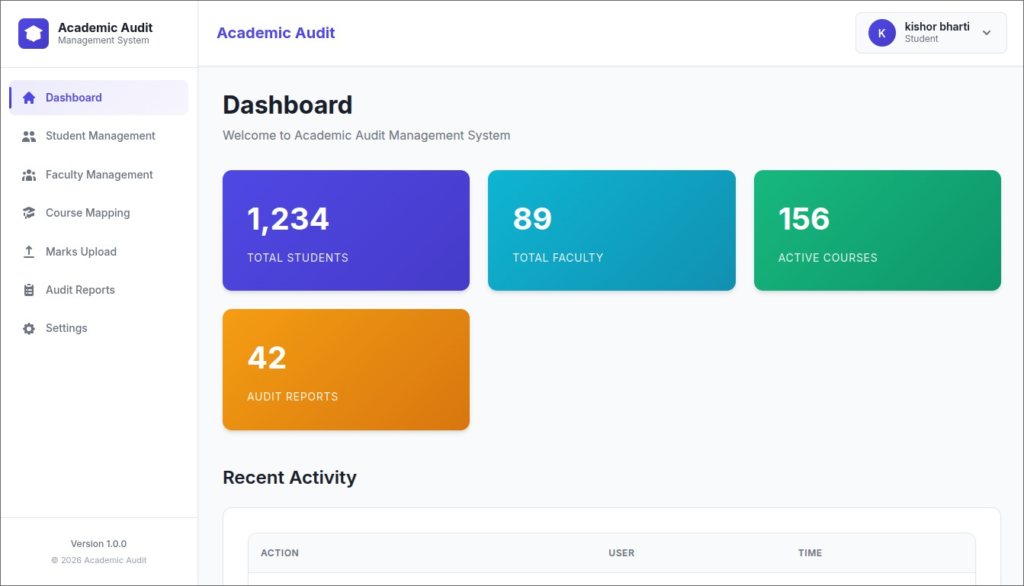
Screenshot – 3 : Dashboard
‹#›
© Bharati Vidyapeeth’s Institute of Computer Applications and Management, New Delhi-63
‹#›
© Bharati Vidyapeeth’s Institute of Computer Applications and Management, New Delhi-63

Slide 14
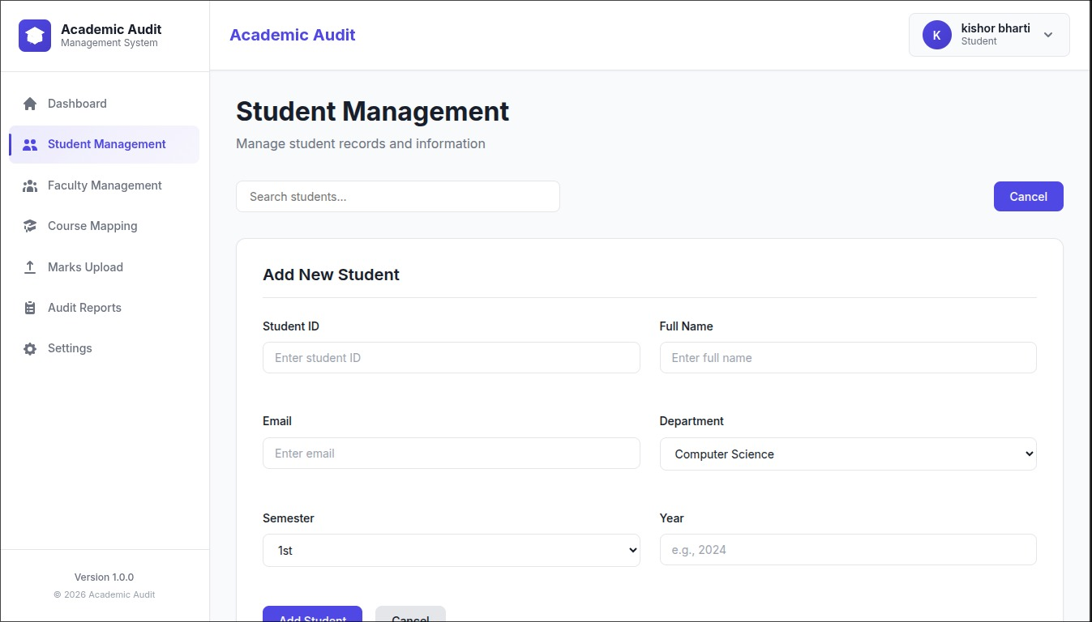
Screenshot – 4 : Student Management:
‹#›
© Bharati Vidyapeeth’s Institute of Computer Applications and Management, New Delhi-63
‹#›
© Bharati Vidyapeeth’s Institute of Computer Applications and Management, New Delhi-63

Slide 15
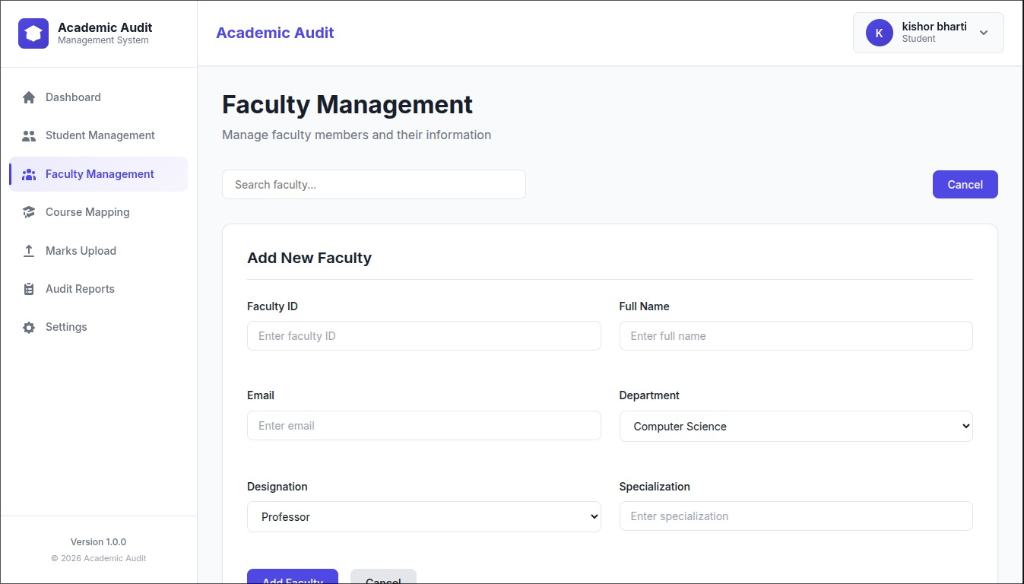
Screenshot – 5 : Faculty Management
‹#›
© Bharati Vidyapeeth’s Institute of Computer Applications and Management, New Delhi-63
‹#›
© Bharati Vidyapeeth’s Institute of Computer Applications and Management, New Delhi-63

Slide 16
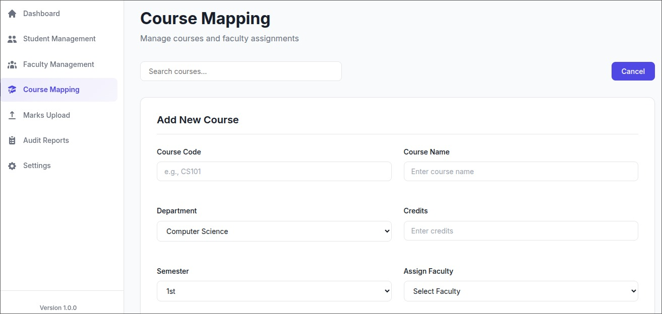
Screenshot - 6 : Course Mapping
‹#›
© Bharati Vidyapeeth’s Institute of Computer Applications and Management, New Delhi-63
‹#›
© Bharati Vidyapeeth’s Institute of Computer Applications and Management, New Delhi-63

Slide 17
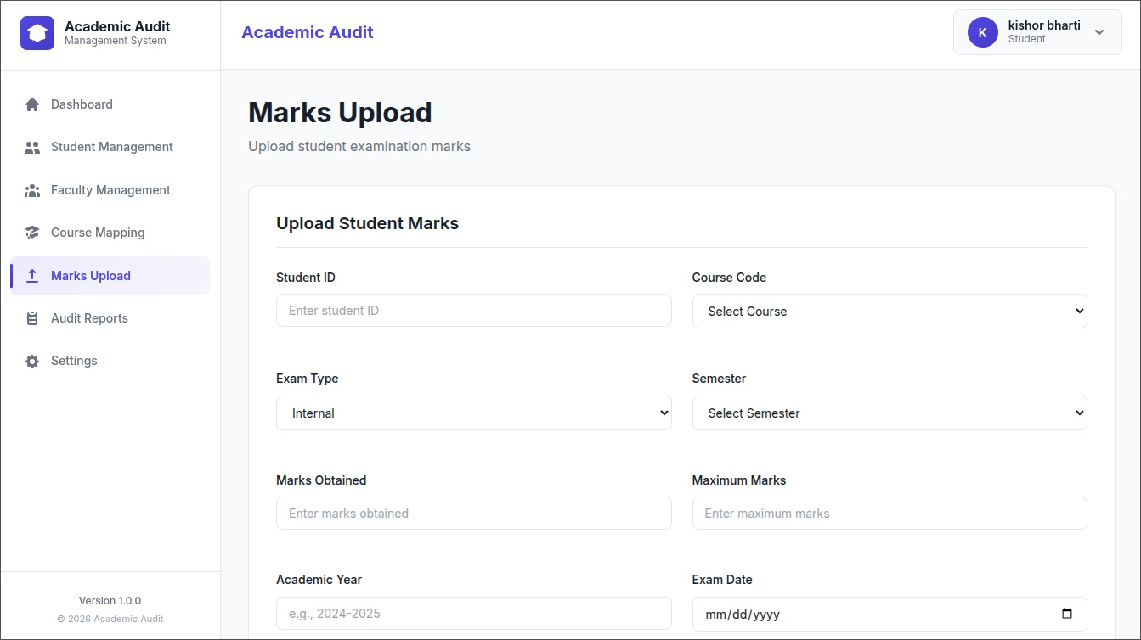
Screenshot – 7 : Marks Upload
‹#›
© Bharati Vidyapeeth’s Institute of Computer Applications and Management, New Delhi-63
‹#›
© Bharati Vidyapeeth’s Institute of Computer Applications and Management, New Delhi-63

Slide 18
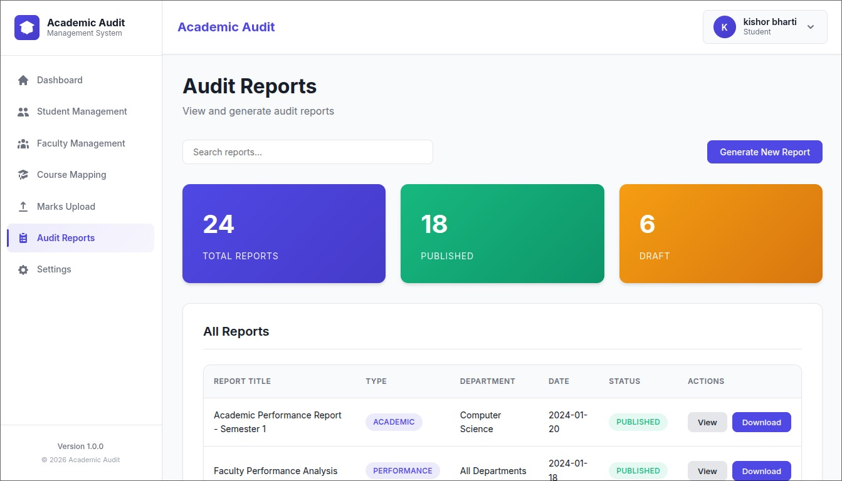
Screenshot – 8 : Audit Reports
‹#›
© Bharati Vidyapeeth’s Institute of Computer Applications and Management, New Delhi-63
‹#›
© Bharati Vidyapeeth’s Institute of Computer Applications and Management, New Delhi-63

Slide 19
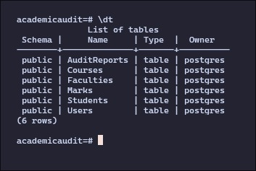
Screenshot – 9 : Schema
‹#›
© Bharati Vidyapeeth’s Institute of Computer Applications and Management, New Delhi-63
‹#›
© Bharati Vidyapeeth’s Institute of Computer Applications and Management, New Delhi-63

Slide 20
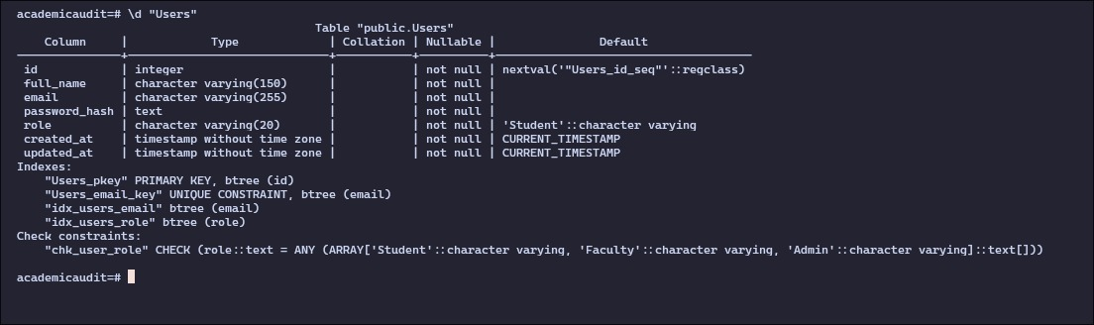
Screenshot – 10 : Users Schema
‹#›
© Bharati Vidyapeeth’s Institute of Computer Applications and Management, New Delhi-63
‹#›
© Bharati Vidyapeeth’s Institute of Computer Applications and Management, New Delhi-63

Slide 21
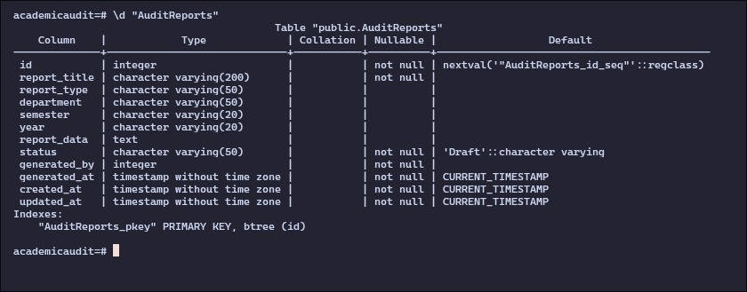
Screenshot – 11 : Audit Reports Schema
‹#›
© Bharati Vidyapeeth’s Institute of Computer Applications and Management, New Delhi-63
‹#›
© Bharati Vidyapeeth’s Institute of Computer Applications and Management, New Delhi-63

Slide 22
Future Scope
Integration with AI for performance analytics and predictions.
Mobile application development for wider accessibility.
Integration with accreditation systems (NAAC/NBA).
Advanced reporting and data visualization dashboards.
Cloud deployment for scalability and multi-college usage.
‹#›
© Bharati Vidyapeeth’s Institute of Computer Applications and Management, New Delhi-63
‹#›
© Bharati Vidyapeeth’s Institute of Computer Applications and Management, New Delhi-63

Slide 23
Conclusion
The Academic Audit Module provides a centralized, secure, and efficient system for managing academic records.
It simplifies student, faculty, course, and marks management while enabling structured audit report generation.
The system enhances transparency, reduces manual effort, and ensures data integrity through modern web technologies.
‹#›
© Bharati Vidyapeeth’s Institute of Computer Applications and Management, New Delhi-63
‹#›
© Bharati Vidyapeeth’s Institute of Computer Applications and Management, New Delhi-63

Slide 24
Thank You
Thank You!
‹#›
© Bharati Vidyapeeth’s Institute of Computer Applications and Management, New Delhi-63
‹#›
© Bharati Vidyapeeth’s Institute of Computer Applications and Management, New Delhi-63

